Slide 1



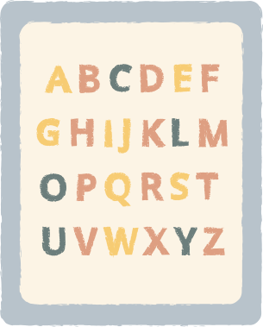








intellisheet
intellisheet
making learning
ai-proof
Malik Lesch, Andrea Rachetta, Dora Mergenthaler, Hauke Huempel

Slide 2





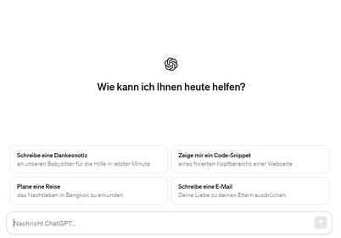



intellisheet
MISSuse
student
of AI in Education
teacher
Gen AI
67%
students
30K
teachers
teacher
Gen AI
student
Notes:
ja, die story so.. das problem:
lehrer erstellen Arbeitsblätter und schüler lösen es dann nicht alleine und insbesondere mit KI

Slide 3


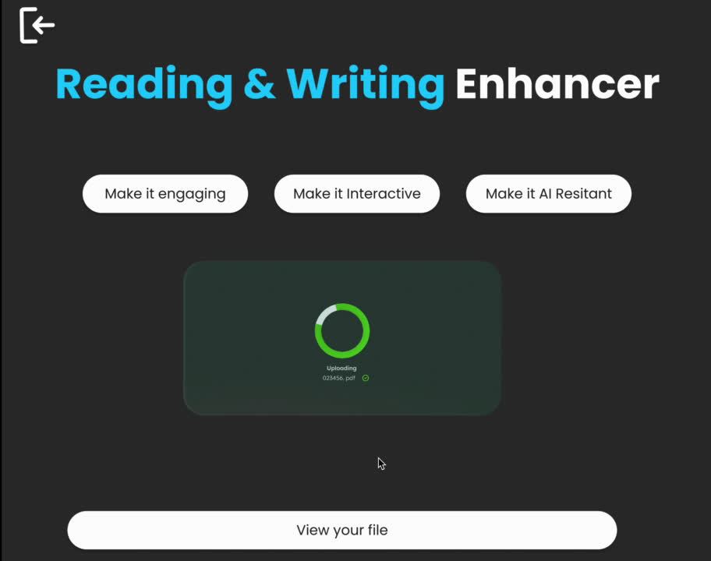



intellisheet
demo/MVP

Slide 4






intellisheet
in the meantime...
Input Layer
AI Model
Output Layer
Processing
Module
Scoring &
Evaluation
Monitoring &
Logging
Text Data
Processing
Enhanced PDF
Generation
Integration

Slide 5




intellisheet
it works!
personalized learning
increased student engagement
69%
28%
improved scores
improved performance of staff
51%
39%
greater student retention

Slide 6
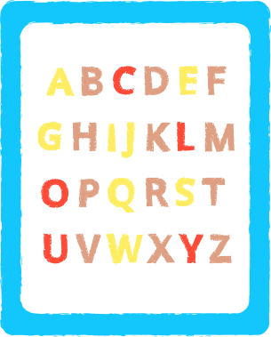





intellisheet
Needed Booster!
e-learning
325 B$ in 2025
Teachers
69 mio
Kids
2,4 B
Homework time
2h/day
Preppingtime
6h/week
Notes:
... Personalization and Adaptive Learning
Collaborative Learning Features
Integration with Learning Management Systems (LMS)
Partnerships with Educational Content Providerseration

Slide 7







intellisheet
Solution
Input
Evaluate
adapt
create

Slide 8
intellisheet
No Copying
more
Thinking
with AI-proof Work Sheets & Assignments

Slide 9


intellisheet
invest
in the future
now
intellisheet

